Slide 1
Employee Promotion
Prediction Using
Machine Learning
HR Analytics Classification Project
Prepared by : Waleed Alshammari
• June 2026
Dataset: Kaggle Employee Promtion Prediction Dataset

Slide 2
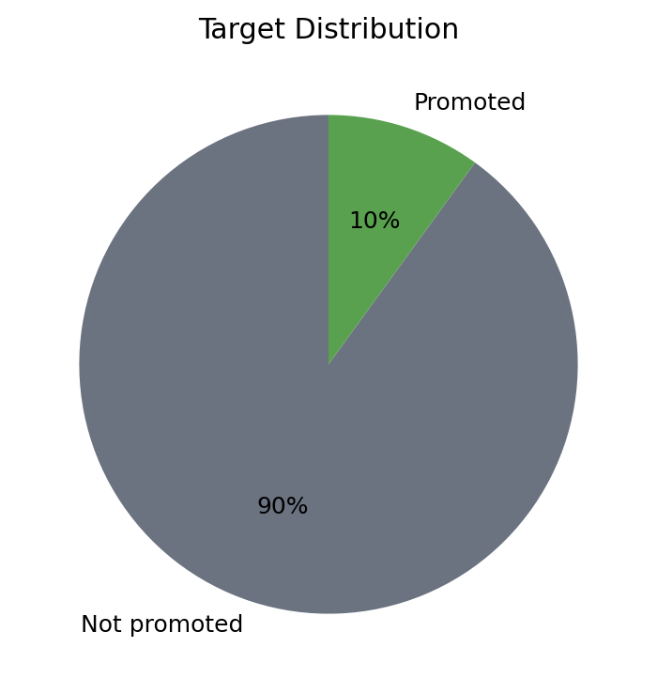
Subject & Dataset
What is being predicted and where the data comes from
SUBJECT
Predict whether an employee will be promoted based on demographic, training, service, performance, and work-related attributes.
100,000 employee records
43 original columns
DATASET LINK
Target: promoted
0 = no, 1 = yes
Binary classification
Kaggle: Employee Promtion Prediction Dataset
https://www.kaggle.com/datasets/rohit8527kmr7518/employee-promtion-prediction
Employee Promotion Prediction | Machine Learning Assignment
02

Slide 3
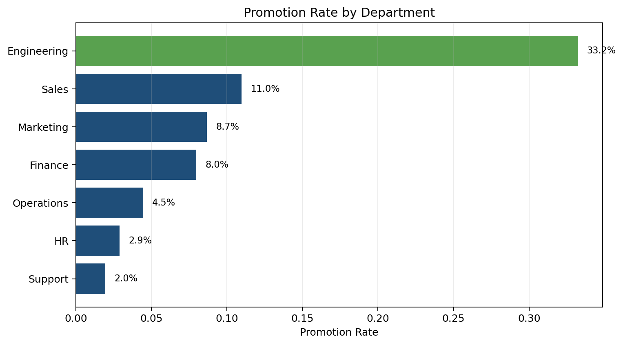
Brief Description of the Project
Applying the machine learning lifecycle to an HR analytics problem
Explore and understand the employee promotion dataset.
Clean and prepare the data for machine learning.
Create useful features to improve prediction quality.
Train Logistic Regression and SVM (Support Vector Machine) models.
Evaluate models and interpret business insights for HR decision-making.
Comment: Engineering has the highest promotion rate, while Support and HR have the lowest. This shows strong variation by department.
Employee Promotion Prediction | Machine Learning Assignment
03

Slide 4
Project Phases and Steps
The full process followed in Google Colab
1
Data Collection
Load Kaggle CSV into Colab
2
Inspection & Cleaning
Check types, null values, duplicates
3
EDA (Explore Distribute Analyze)
(Explore distributions, relationships, imbalance
4
Feature Engineering
Create service and training related features
5
Model Building
Train Logistic Regression and SVM (Support Vector Machine)
6
Evaluation
Compare metrics, confusion matrices, and feature importance
Output: a well-documented notebook and presentation that explain the workflow, results, and conclusions.
Employee Promotion Prediction | Machine Learning Assignment
04

Slide 5
Dataset Inspection
Basic structure and columns used for analysis
Rows
100,000
Columns 43
Numerical
36 columns
Categorical
6 columns
KEY COLUMNS
Performance: performance_score, performance_last_year, manager_rating, peer_feedback_score.
Workload: avg_monthly_hours, overtime_hours, tasks_completed.
Development: training_hours_last_year, certifications_count, skill_assessment_score.
HR/Compensation: salary, salary_increase_percent, bonus_last_year.
Target: promoted.
Employee Promotion Prediction | Machine Learning Assignment
05

Slide 6
Methods Used
Data preparation, feature engineering, and machine learning models
PREPROCESSING
MODELS
Null values handled through imputation.
Numerical variables scaled for Logistic Regression.
Categorical variables one-hot encoded.
Identifier columns such as employee_id removed.
Logistic Regression
Interpretable baseline model
SVM (Support Vector Machine)
Captures non-linear patterns and interactions
FEATURE ENGINEERING
Service-to-age ratio.
Training efficiency.
Conditionally created only when required columns exist.
Train/test split used stratification to preserve the 90/10 class distribution.
Employee Promotion Prediction | Machine Learning Assignment
06

Slide 7
Statistical Methods Used
Methods applied to answer analytical questions and evaluate results
Descriptive statistics
Used to summarize columns and understand variable ranges.
Correlation analysis
Pearson correlation measured salary-performance relationship.
OLS regression
Tested whether salary predicts performance score.
Group means
Compared departments and remote work patterns.
Feature importance
Identified drivers of promotion, manager rating, and peer feedback.
Classification metrics
Accuracy, precision, recall, F1-score, ROC-AUC.
Employee Promotion Prediction | Machine Learning Assignment
07

Slide 8
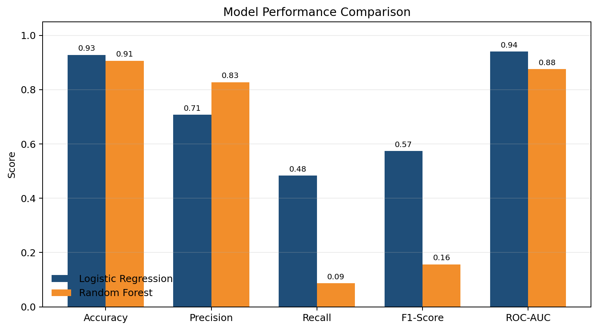
Model Results
Performance comparison between two classification models
COMMENTS
Logistic Regression achieved stronger overall balance: Accuracy 0.9283, F1-score 0.5740, ROC-AUC 0.9402.
SVM had higher precision for promoted employees, but very low recall of 0.0865.
Because promotion is imbalanced, F1-score and recall are important in addition to accuracy.
SVM
Best practical model in this run: Logistic Regression
Employee Promotion Prediction | Machine Learning Assignment
08

Slide 9
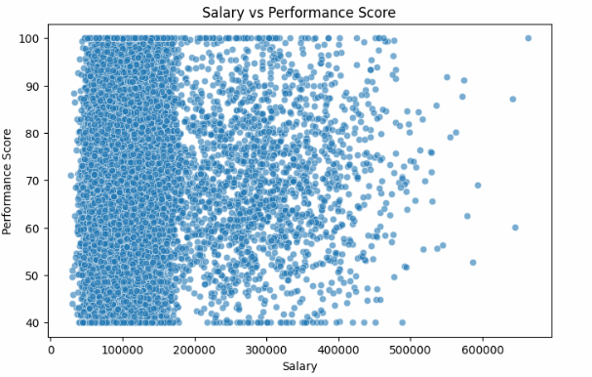
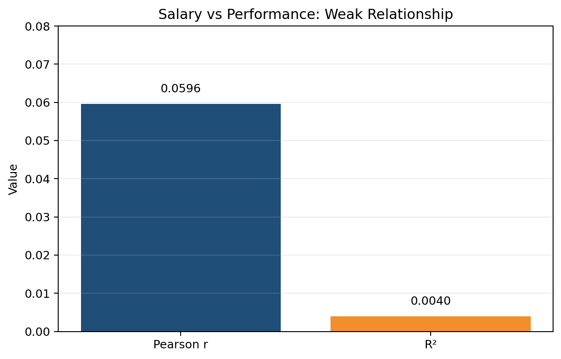
Result 1: Salary vs Performance Score
Question 1: What is the relationship between an employee's salary and their performance score?
Comment: The relationship is statistically significant but practically weak. Salary alone is not a strong predictor of performance score.
Employee Promotion Prediction | Machine Learning Assignment
09

Slide 10
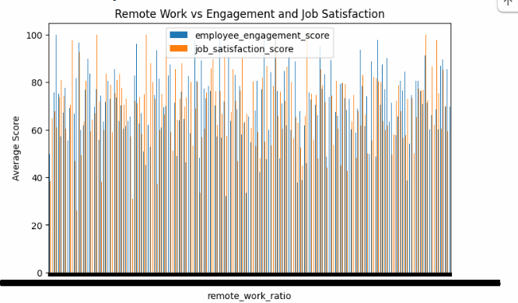
Result 2: Remote Work Impact
Question 2: Does working remotely impact employee engagement and job satisfaction scores?
Remote variable used:
remote_work_ratio
Outcomes analyzed:
employee_engagement_score
job_satisfaction_score
Method:
group comparison / correlation approach
IMPORTANT OBSERVATION
The document output shows remote_work_ratio as a continuous variable with many unique values, not a simple 0/1 remote-work category. Therefore, the correct analysis should treat it as a ratio and compare its relationship with engagement and satisfaction scores.
Comment: Further analysis should use correlation/regression or convert remote_work_ratio into categories such as Low, Medium, and High remote work before comparing average engagement and satisfaction.
Employee Promotion Prediction | Machine Learning Assignment
10

Slide 11
Result 3: Promotion Rates and Key Drivers
Question 3: Which departments have the highest rates of promotion, and what are the key drivers?
Comment: Engineering has the highest promotion rate at 33.2%. The most influential promotion drivers are recent performance, current performance score, tasks completed, KPI achievement, and salary.
Employee Promotion Prediction | Machine Learning Assignment
11

Slide 12
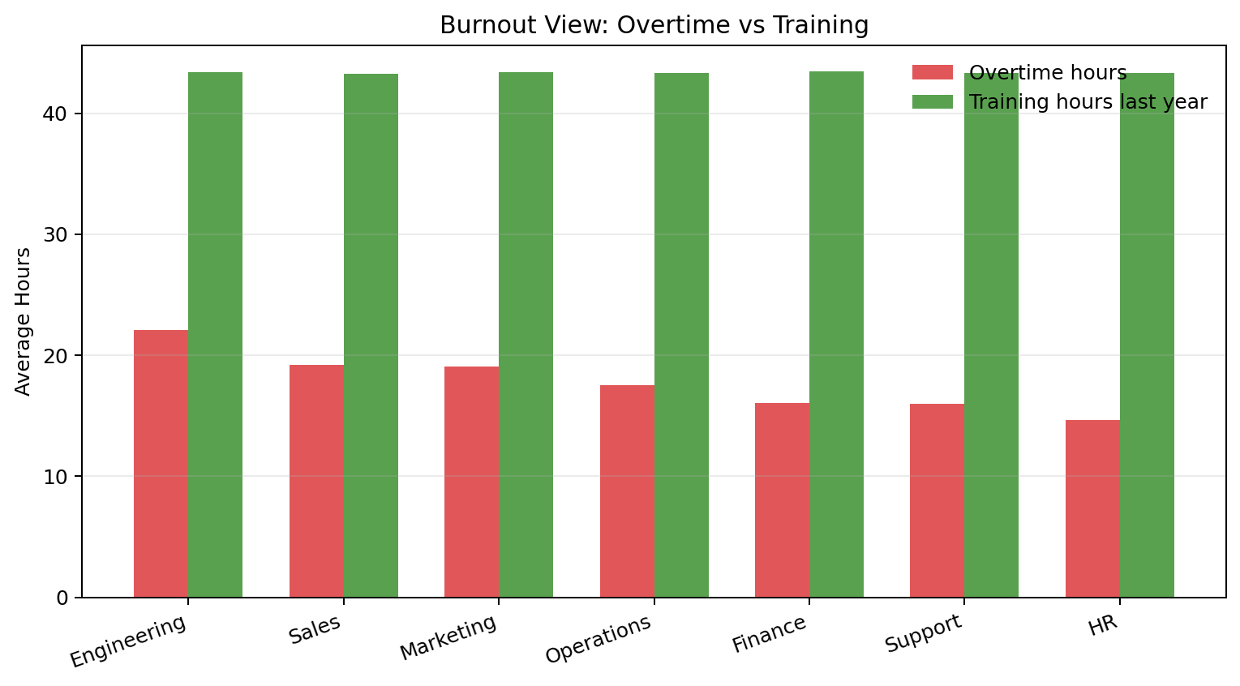
Result 4: Burnout Across Teams
Question 4: How does employee burnout look across different teams? (Analyzing Overtime vs. Training)
Comment: Engineering shows the highest average overtime hours. Training hours are similar across departments, so departments with higher overtime represent higher workload pressure and stronger burnout risk.
Employee Promotion Prediction | Machine Learning Assignment
12

Slide 13
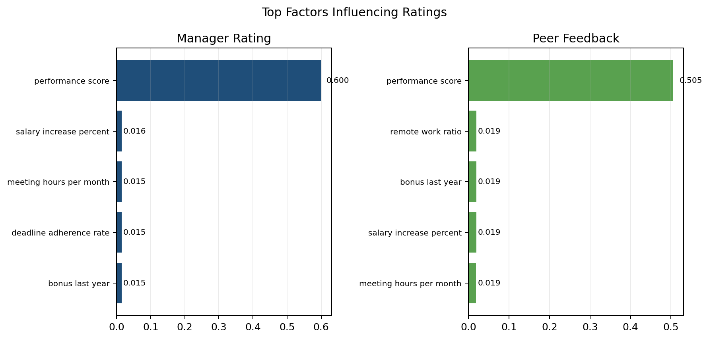
Result 5: Rating and Peer Feedback Drivers
Question 5: What factors most heavily influence an employee’s manager_rating and peer_feedback_score?
The models show that performance_score dominates both manager and peer evaluation. Other variables have much smaller but still measurable influence.
Employee Promotion Prediction | Machine Learning Assignment
13

Slide 14
Conclusion
Main findings and final interpretation
Machine learning can support HR analytics by identifying promotion patterns and important employee factors.
Logistic Regression performed better overall in this experiment, especially by F1-score and ROC-AUC.
Engineering had the highest promotion rate, and performance-related variables were the strongest promotion drivers.
Salary has a statistically significant but very weak relationship with performance score.
Burnout risk is highest where overtime is high, especially in Engineering.
Performance score is the most important factor influencing both manager rating and peer feedback score.
Final takeaway
Sum-up:
The project shows how data science can improve workforce planning and support fair, evidence-based promotion decisions.
Employee Promotion Prediction | Machine Learning Assignment
14

